Slide 1




Project EDDIE: Stream Discharge
Bader, N.E., T. Meixner, C.A. Gibson, C.M. O’Reilly, and D.N. Castendyk. 26 June 2015. Project EDDIE: Stream Discharge Module. Project EDDIE Module 5, Version 2.
http://cemast.illinoisstate.edu/data-for-students/modules/stream-disharge.shtml.
Module development was supported by NSF DEB 1245707.

Slide 2
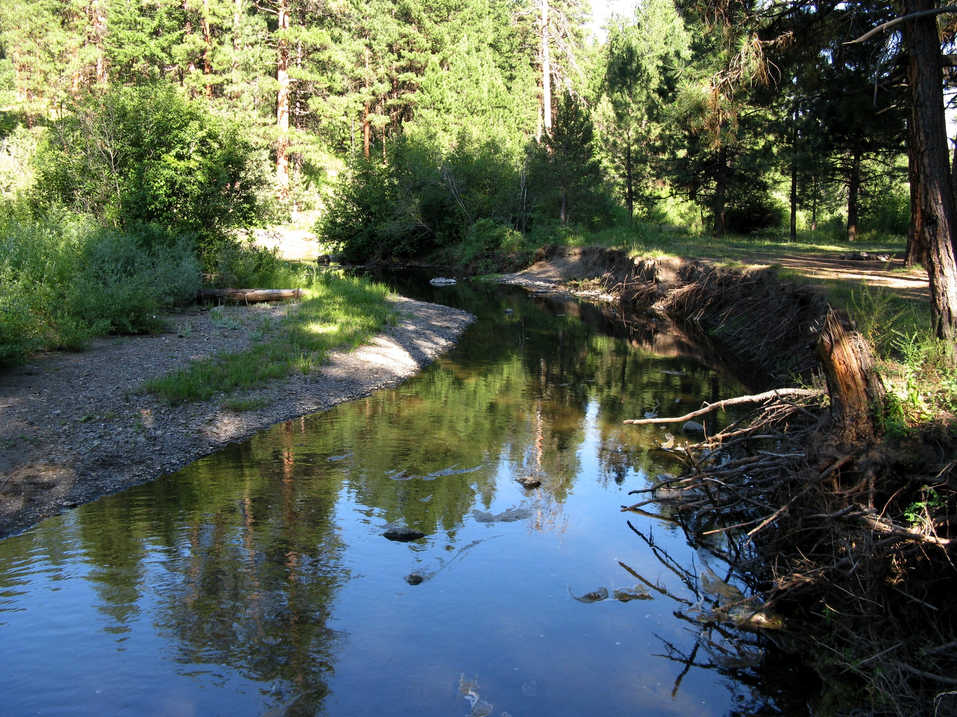
North fork of the Burnt River, Wallowa Whitman National Forest, Blue Mountains, 2009

Slide 3
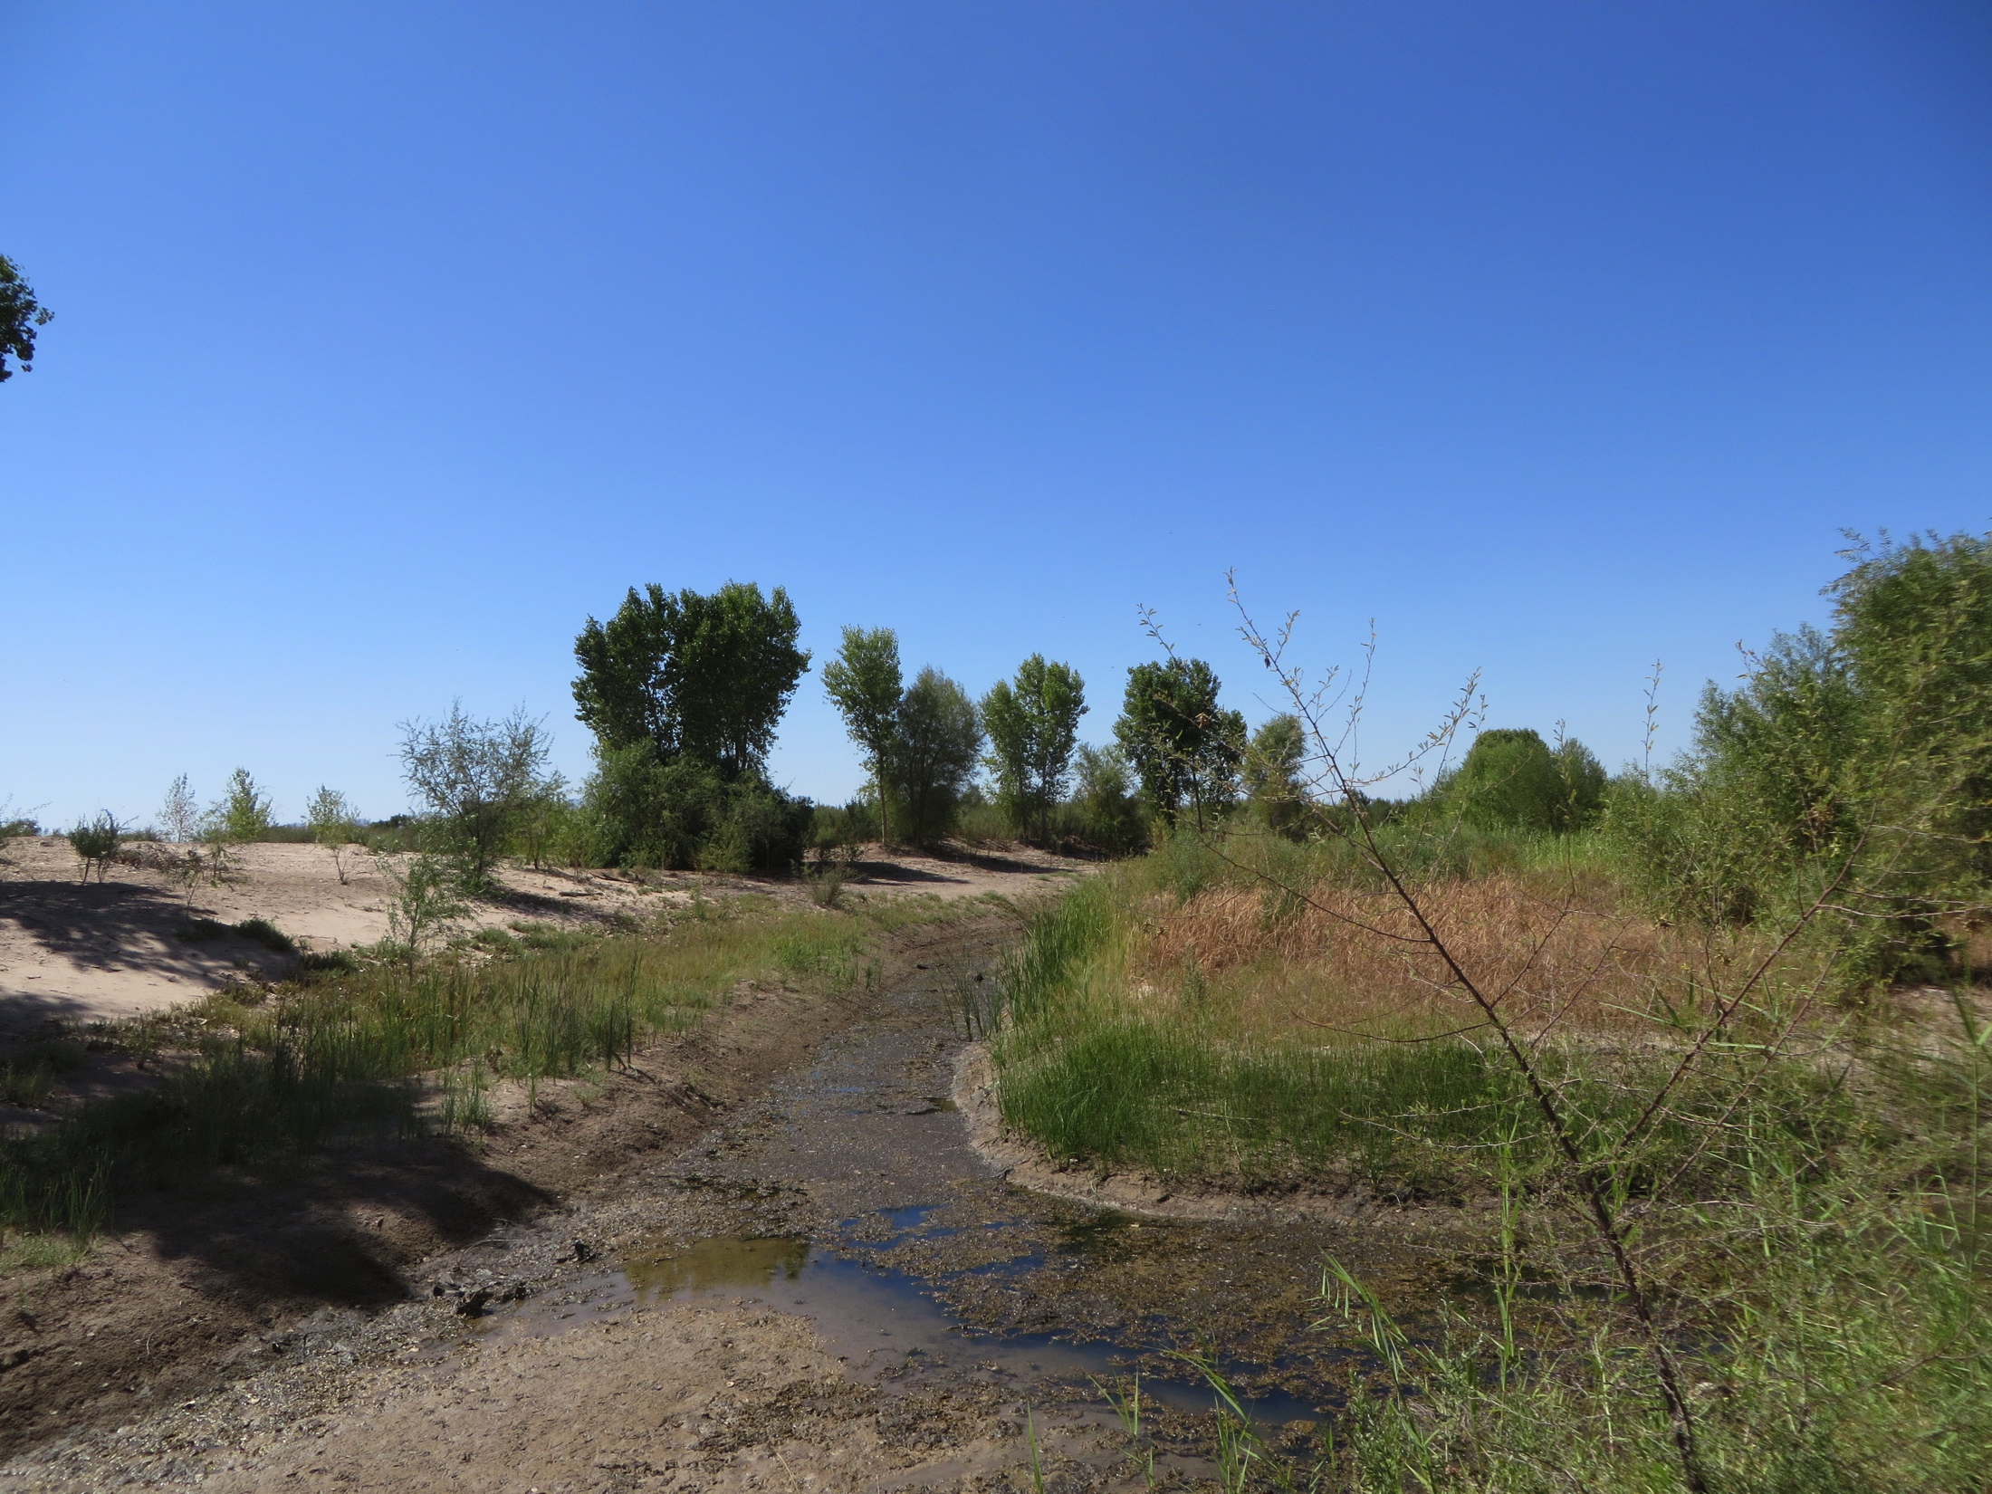
Below Morelos Dam, four months after the end of the spring 2014 pulse flow to the Colorado River delta: light green cottonwood and willow seedlings line the channel. The site was cleared of non-native vegetation and graded to promote river flow by the Sonoran Institute before the start of the pulse flow. (Photo: Karl W. Flessa)

Slide 4
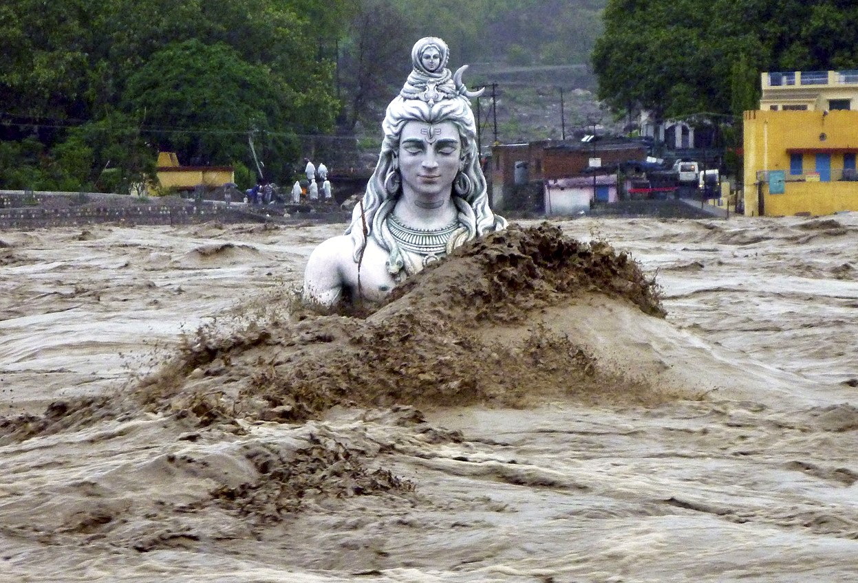
A submerged idol of Shiva stands in the flooded River Ganges in Rishikesh, in the northern Indian state of Uttarakhand, 18 June 2013; monsoon rains arrived early in 2013 (AP photo)

Slide 5
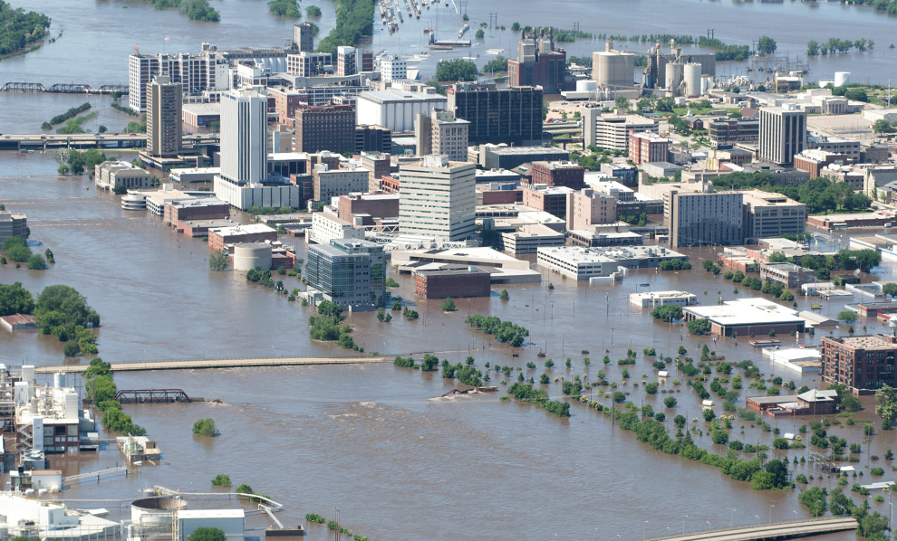
Mississippi floodwaters in Cedar Rapids, Iowa, 13 June 2008 (AP photo)

Slide 6
Two equivalent ways to think of discharge:
1. Volume flowing past a point on a streambank per second:
2. Mean velocity of the water as it flows through a cross-sectional area of stream channel:

Slide 7
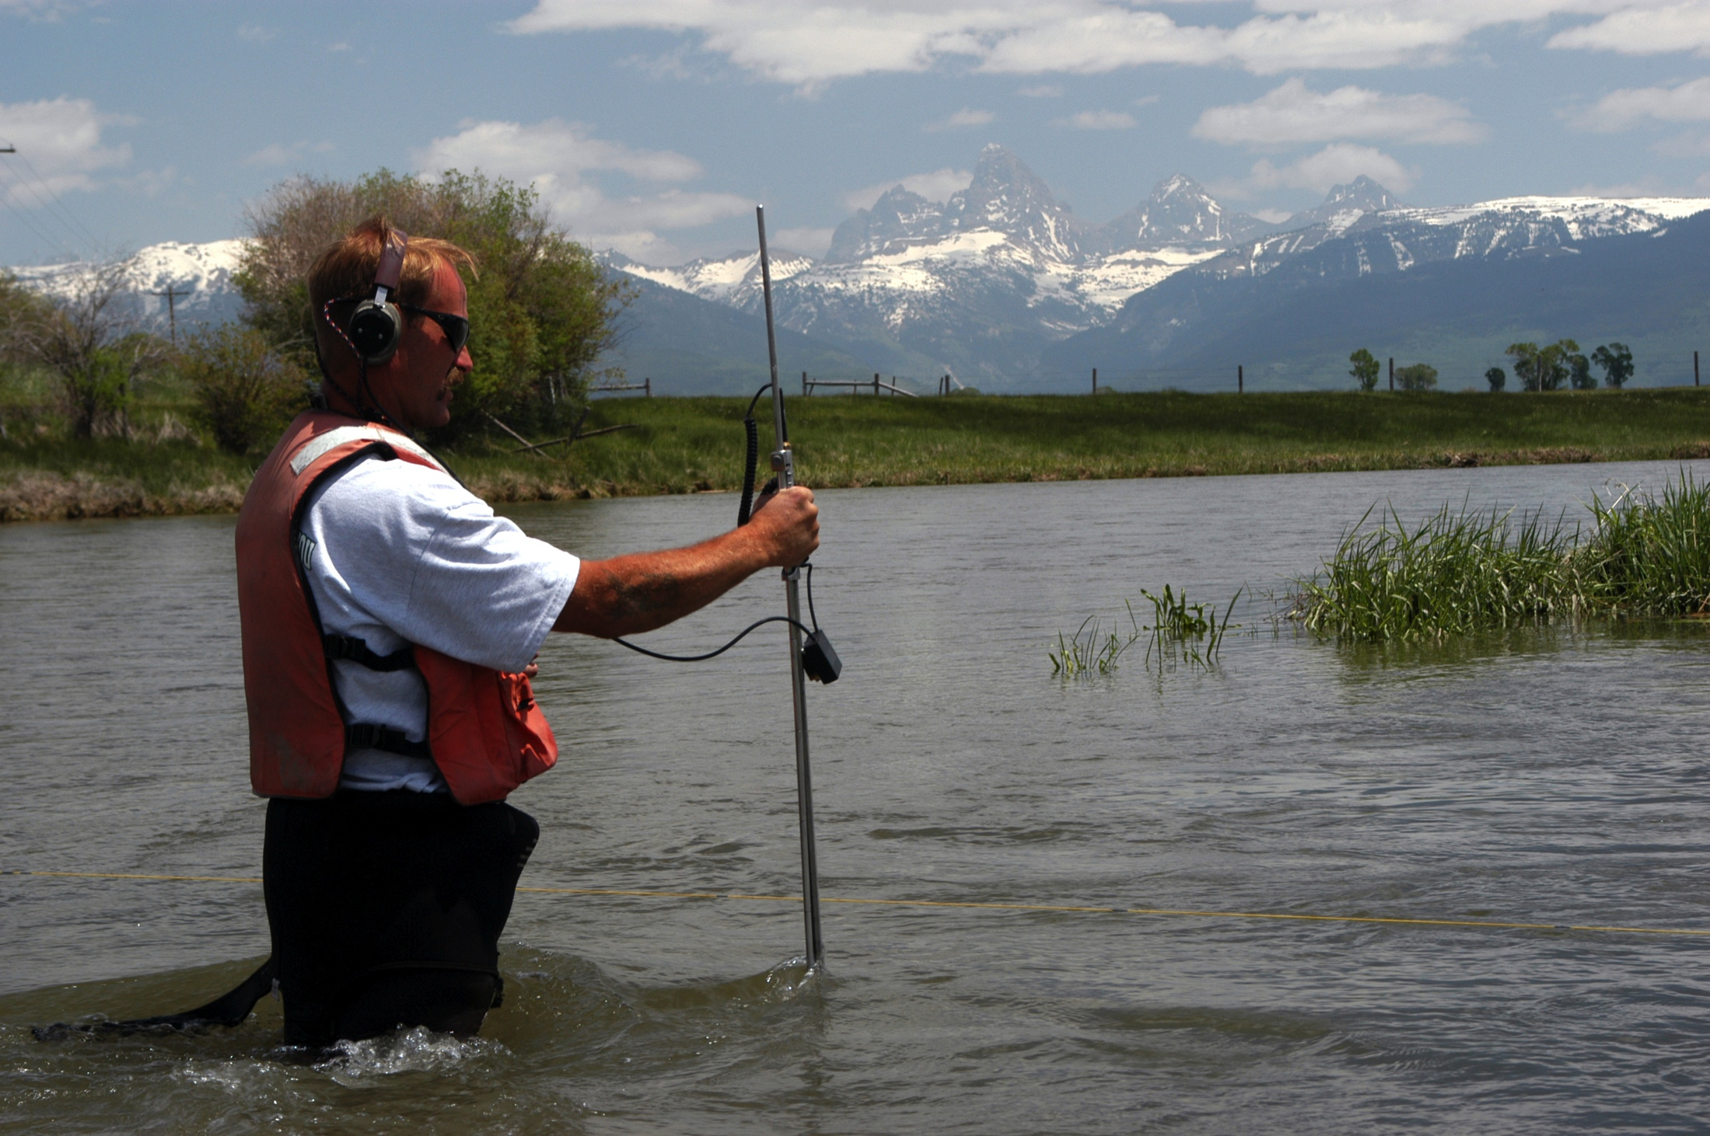
Wading measurement, Teton River at South Leigh Creek near Driggs, Idaho. Photo: Mike Nolan

Slide 8
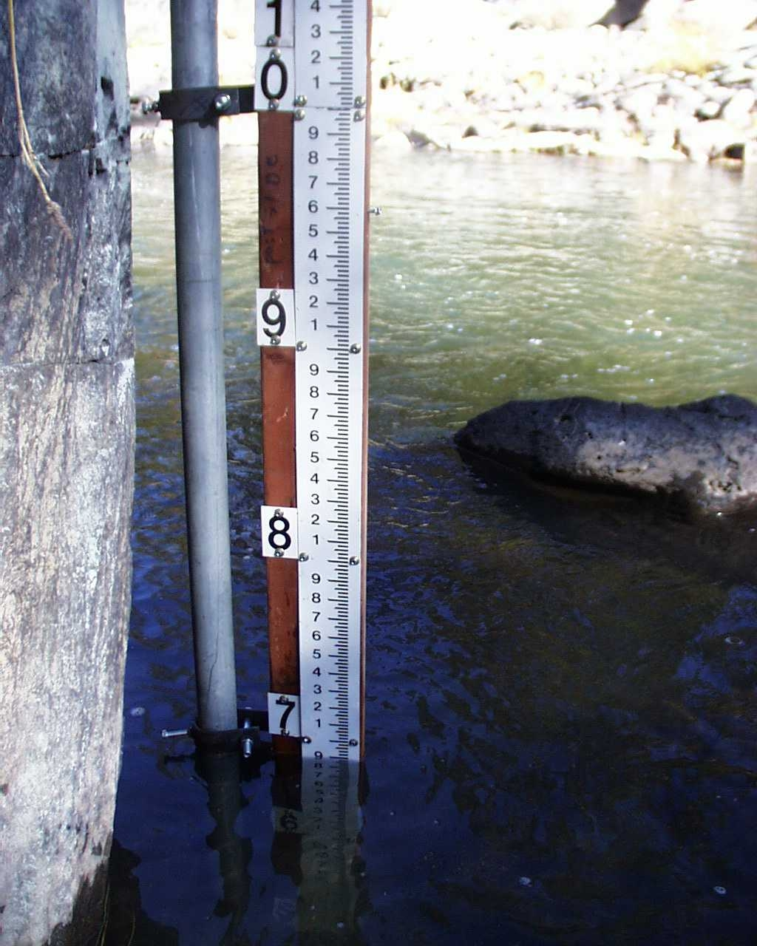
Staff gage at Indian Creek, CA. Photo: California Department of Water Resources, Northern District

Slide 9
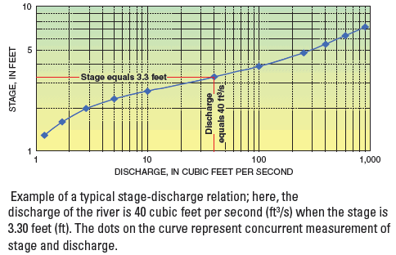
Streams
Image: USGS

Slide 10
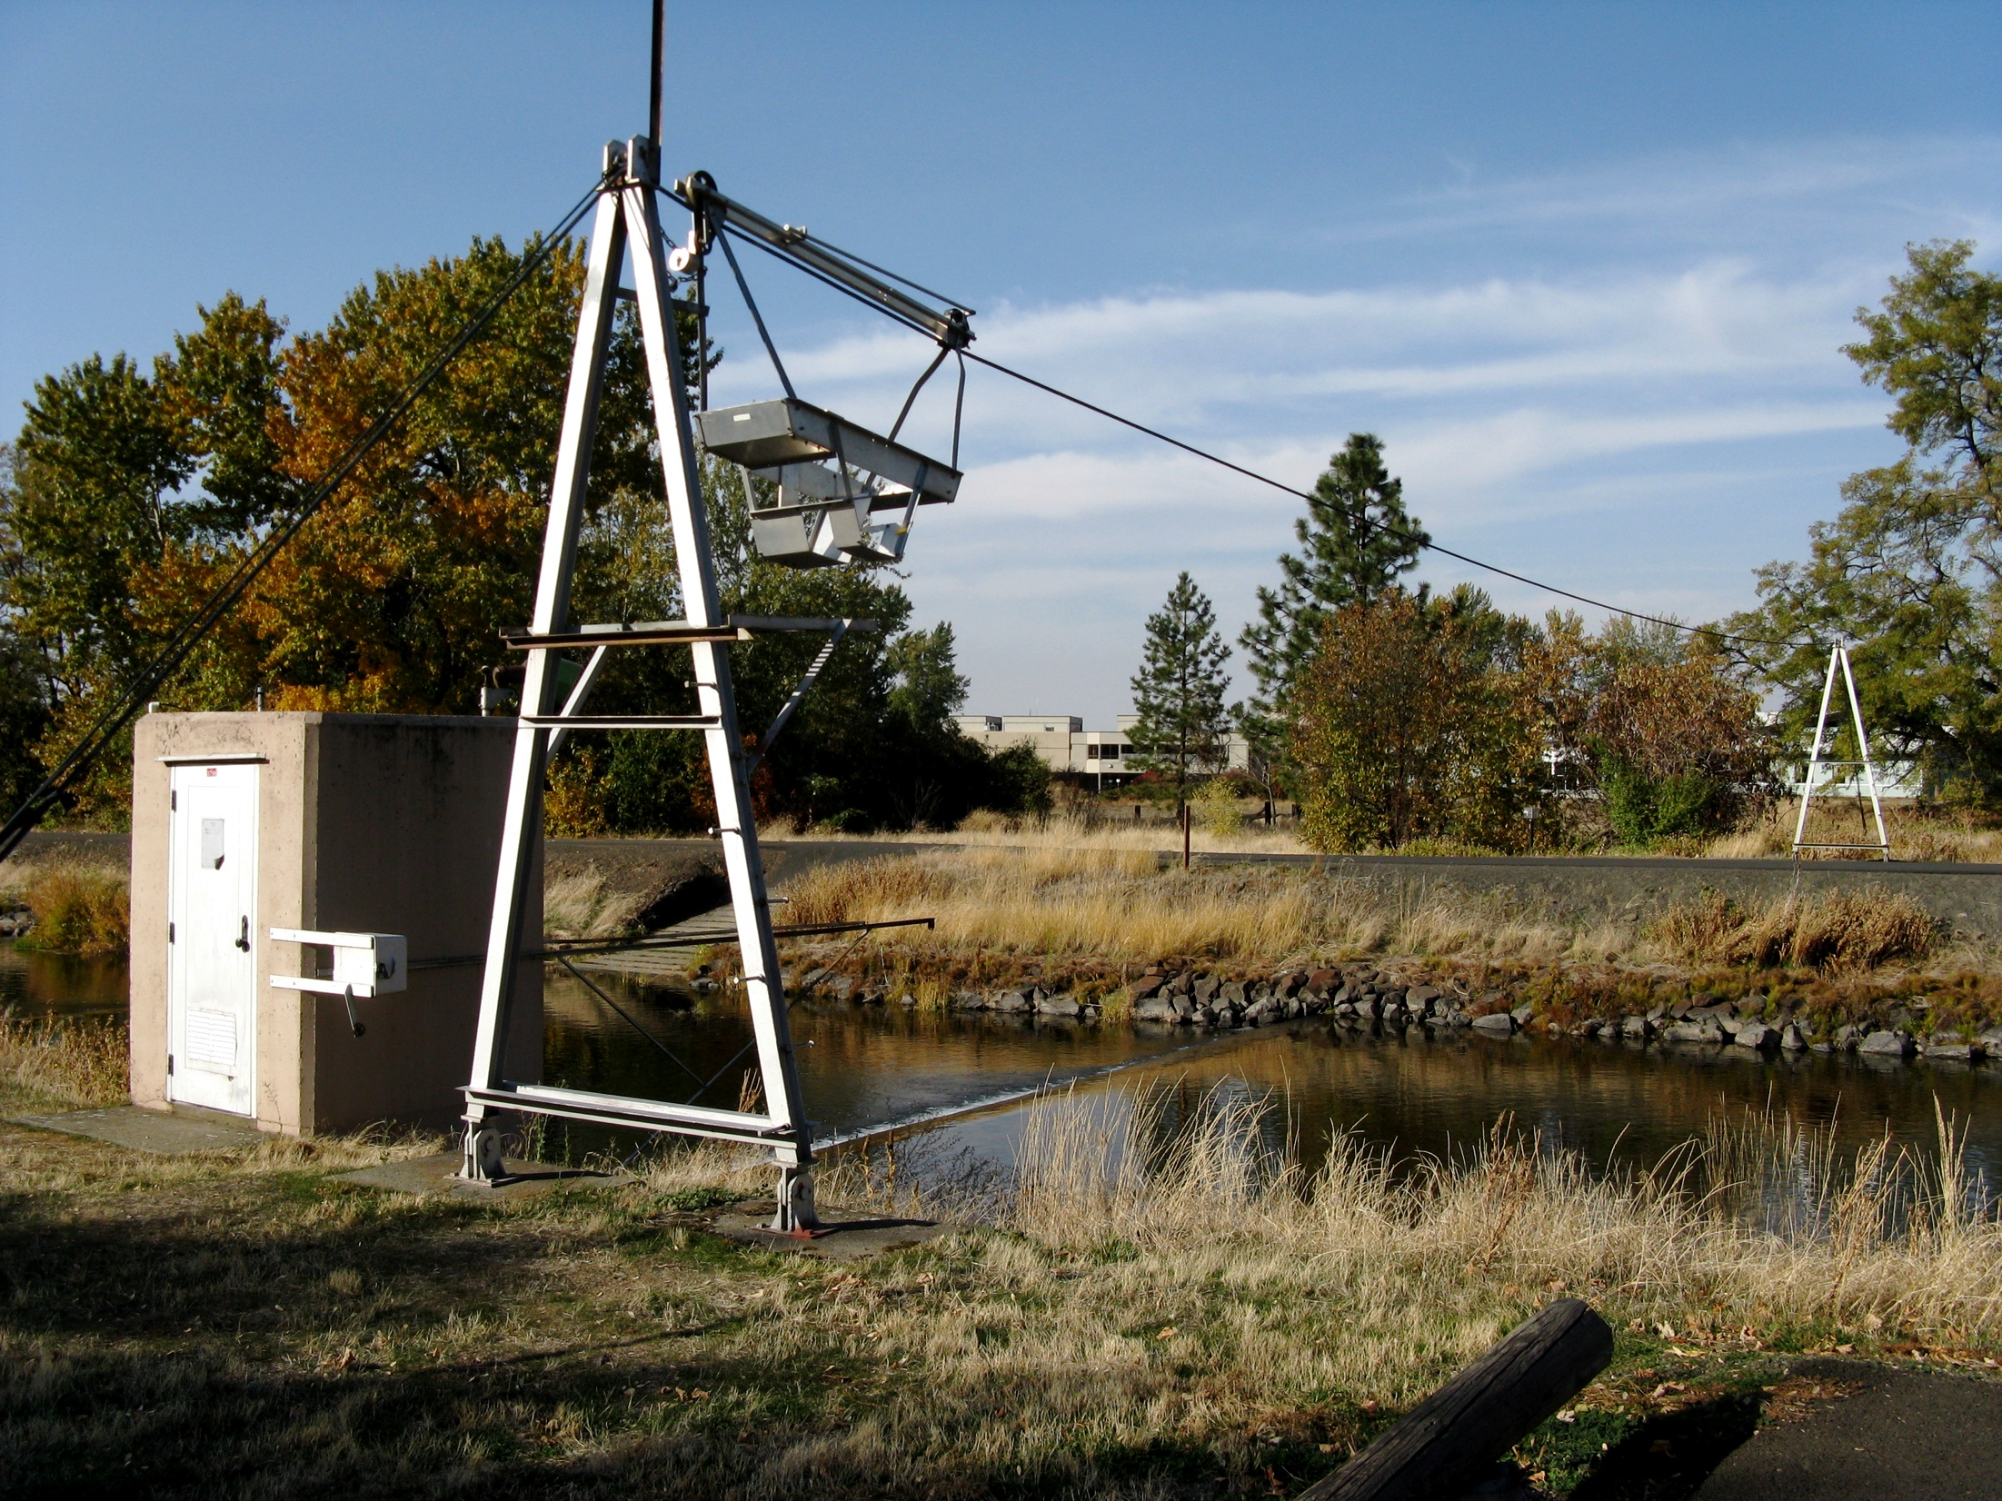
Gaging station on Mill Creek, October 2008 (Photo: Nick Bader)

Slide 11
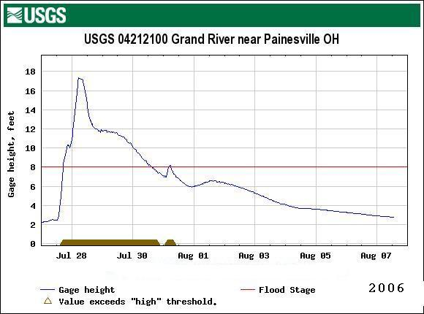
Hydrograph of the Grand River, Painesville, Ohio, during a 2006 flood event. Graphic: USGS

Slide 12
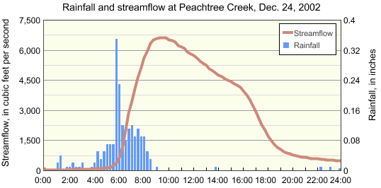
Streams
Image: USGS

Slide 13
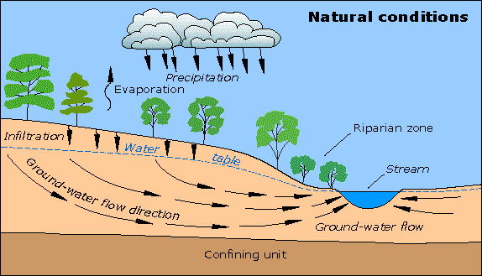
Streams
Image: USGS

Slide 14
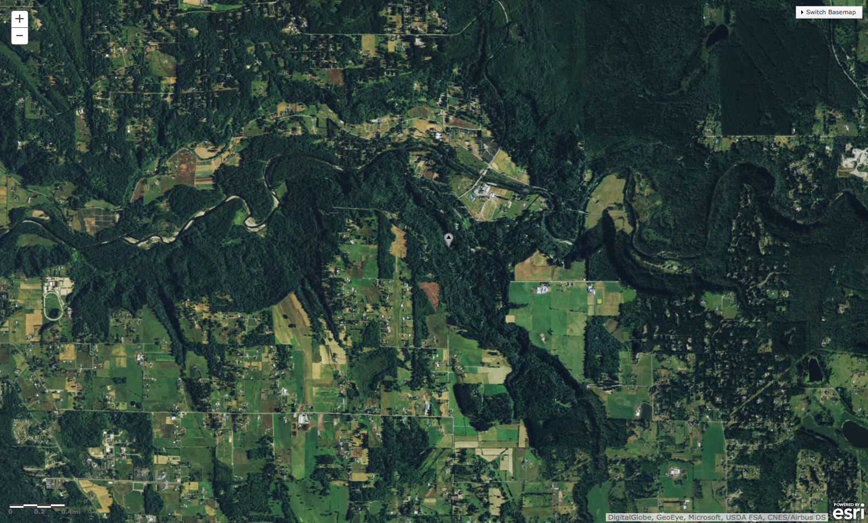
USGS gaging station 12108500, Newaukum Creek near Black Diamond, Washington (red circle). Newaukum Creek flows north into Green River, which flows west. This drainage is in a forested semi-rural setting, which has not changed greatly since peak streamflow data begins in 1945. Data from the USGS; imagery provided by ESRI using images from DigitalGlobe, GeoEye, Microsoft, USDA FSA, and CNES/Airbus DS

Slide 15
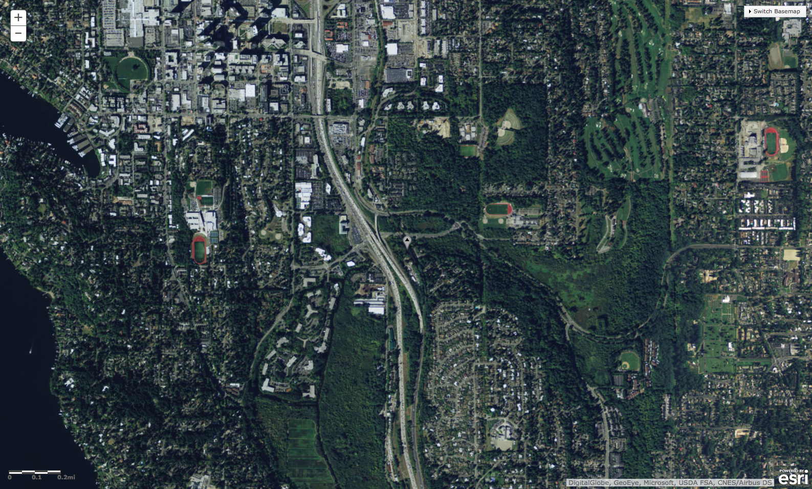
USGS gaging station 12120000, Mercer Creek near Bellevue, Washington (red circle). Mercer Creek flows south-southwest under I-405 into Mercer Slough. Rapid urbanization began in this area in the late 1970s. Data from the USGS; imagery provided by ESRI using images from DigitalGlobe, GeoEye, Microsoft, USDA FSA, and CNES/Airbus DS

Slide 16
Streams

Slide 17
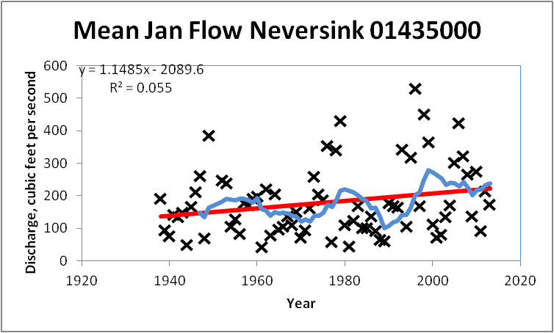

Slide 18
